Slide 1
SAACHI
Olivia Cohen • 06.20.2023 - 08.28.2023

Slide 2

Projects
Market Information
Shopify
Postcardmania
Influencers

Slide 3
Market Information

Slide 4
Population Numbers
As of 2020 there are 73,687,000 women between the ages 45-84.
Around 52,596,000 women aged 45+ shop online in the US.
In 2025 there is a projected 77,491,000 women between the ages 45-84.
In 2030 there is a projected 81,556,000 women between the ages 45-84.
As of 2023 the average income of women 45+ is $53,129 a year.

Slide 5
Population Numbers Breakdown
Of the 73,687,000 Women as of 2020
45 to 64: 42,650,000
65 to 85: 31,037,000
85 and over: 4,283,000
Of the projected 77,491,000 women in 2025
45 to 64: 41,565,000
65 to 85: 35,926,000
85 and over: 4,670,000
Around 20 million are in the top 25% making over $67,000 a year
Around 10.51 million women will be 45-50 in the 5 years

Slide 6
General Migration Patterns
The number of people that moved in 2022 was down compared to previous years.
Southern states remained main destinations
South Carolina, North Carolina, Tennessee, Arizona, and Florida.
For the fourth year in a row, Illinois has the largest percentage of people moving out of the state.
Tennessee, North Carolina, and South Carolina have consistently been on the list of top states since 2020.
Many of the moves revolve around the flexibility of remote work and those choosing to take the route of early retirement.

Slide 7
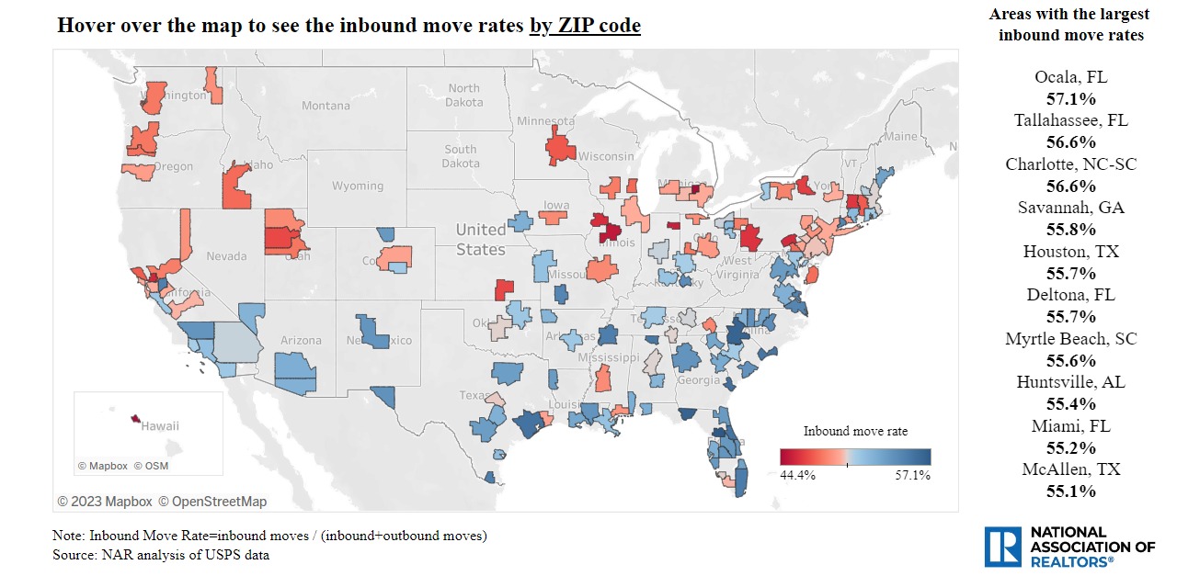
Inbound Move Rate Map (all ages)

Slide 8
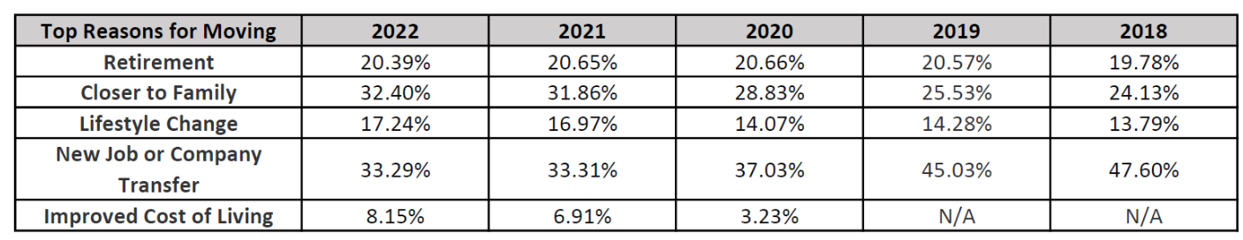
Where are 45+ People Migrating To
Las Vegas, Phoenix, Tampa, Orlando and Austin are the most popular destinations for baby boomers
Especially for retirement
Currently Baby Boomers and Gen Xers drove the shifts in migration, with Eastern states seeing the highest inbound moves with Vermont and New Jersey having some of the highest inbound move rates.

Slide 9
Shopify Customers

Slide 10
Segmentation
Geographic
Suburbs
Midwest and South
Psychographic
Social Life
Hobbies
Lifestyle
Demographic
Age
Education
Income
Gender

Slide 11
Micro Segmentation
Age: Younger customers (under 35) are interested in trendy, fashion-forward pieces, while older customers (over 55) prefer more classic, timeless styles.
Income: Customers with higher incomes are more likely to purchase higher-priced items, while customers with lower incomes can be more price-sensitive.
Occupation: Customers in certain occupations, such as lawyers or doctors, can be more likely to purchase certain types of jewelry, such as cufflinks or necklaces.
Education: Customers with higher levels of education are likely to appreciate the craftsmanship and design of high-quality jewelry.
Location: Customers in certain geographic areas, such as coastal cities or resort towns, can be more likely to purchase beachwear or other seasonal items.
Family status: Customers with children may are more likely to purchase practical items, such as scarves or ponchos, while customers without children are more likely to purchase more decorative items, such as jewelry or handbags.

Slide 12
Overall Target Market For Saachi
45-75 years old
Highly educated
Usually Undergrad and higher
High income
Avg home over $1 million
Common Occupations- Doctor, Lawyer, Nurse, Executive Director, Etc.
U.S. - the South or Midwest
Often in Suburbs close to Major cities (Chicago, NY, Atlanta, Etc.)
Likes to travel
Attends social events
Has a family
Many Older consumers were widows

Slide 13
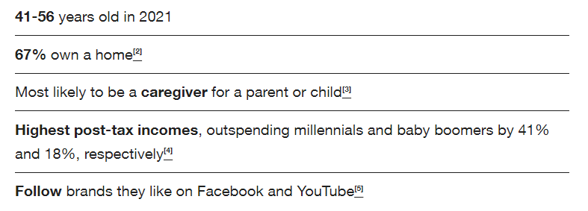
Breaking Down the Target Market: Ages 45-55
Highly educated
Is frequently on social media
Spends more on accessories (jewelry and scarves)
Mostly married
More cost sensitive with less disposable income

Slide 14
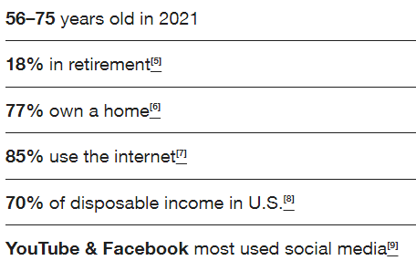
Breaking Down the Target Market: Ages 55-75
Discovery and Adventure
Boomers are adventurous
This we see coming into play with our consumers and traveling
Has more disposable income
Often married or widowed with children
Highly educated

Slide 15
Motivations
Professional / Social
Going to elegant hospital galas - need a scarf to match to get compliments
Going to Daughters Wedding Rehearsal
Going on a girls Trip
Need to look professional at the Law office
Personal
Husband Died, Need to Feel better about themselves
Gifts for family

Slide 16
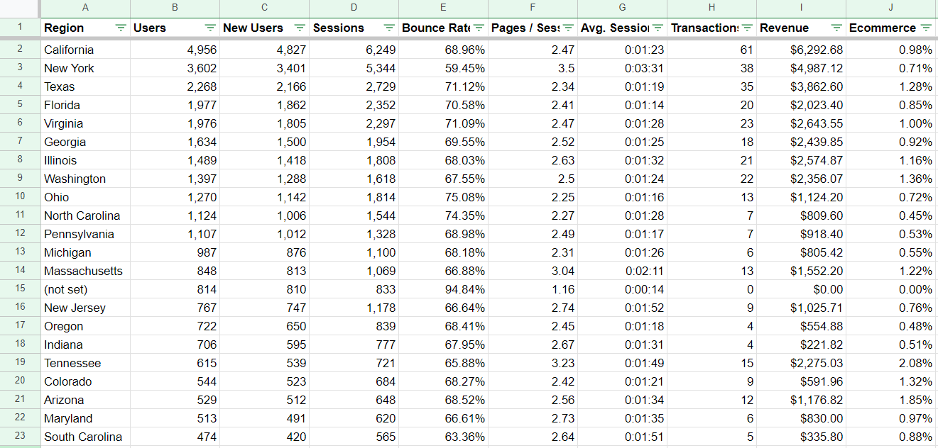
Geographical Location of Consumers T0p 20

Slide 17
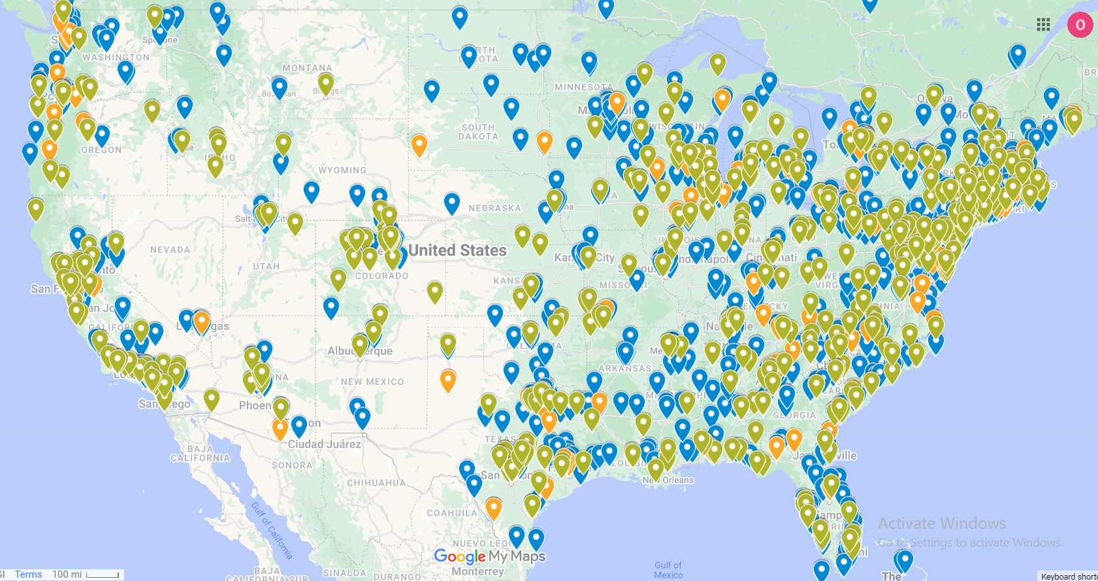
Geographical Location of Boutiques

Slide 18
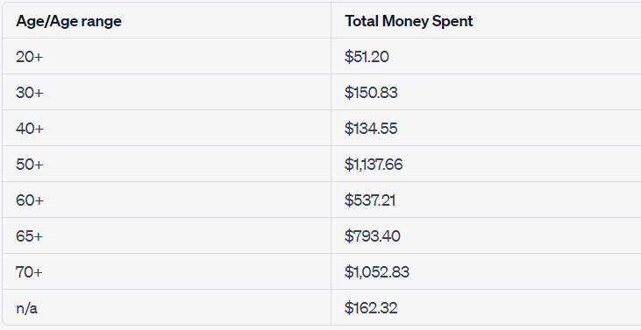
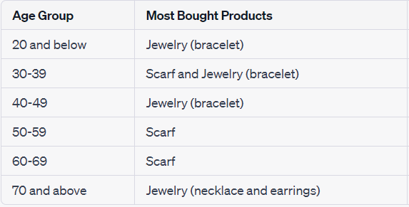
Data Specifics: Bard
Total Money Spent by Age
Most Bought Product by Age

Slide 19
Video Replays Observed Activities
What people like? What makes them buy?
Discount → Though not everyone uses it when the discount pops up most people add to cart
Visual → a lot of people justy added to cart by looking at picks alone
Visuals are the most important feature driving people to purchase
On desktop more people look at description and brand story
What makes people hesitate?
People will add to cart and leave page
People will go back to item and add different colors
Overall not sure if item is exactly what they want
Or want time to think about it before purchasing

Slide 20
How Customers Find Saachi
Google ads: The products they are most being bought through this are kimono, scarf, jewelry (bracelet)
Organic: The products they are most being bought through this are kimono, scarf, jewelry (bracelet)
Direct: The products they are most being bought through this are cardigan, scarf, jewelry (bracelet)

Slide 21
Secondary Information

Slide 22
Postcardmania Research
More than any other generation, boomers say they would be very disappointed if they stopped getting mail, at 57%, compared to 45% of Gen X, 41% of millennials and 37% of Gen Z.
71% of boomers say that mail feels more personal than digital communications. 57% of boomers would be very disappointed if they didn’t receive mail.
More than any other generation, boomers prefer to read promotional deals and communications via direct mail rather than email.
2/3 of boomers have a better impression of a brand that sends out relevant mail.
1/3 of boomers visited a brand’s website after receiving relevant marketing mail.
Consumers are more likely to look at mail from brands they’ve interacted with in the past.
Loyalty programs, on the other hand, are less important to boomers than to other generations, with just 24% of boomers citing them as the most important factor when choosing an online retailer.

Slide 23
Postcard Recommendations
Use higher-quality or thicker materials; these show that you’ve taken care to send out something special.
Use eye-catching colors and unique shapes that set your mailpieces apart.
Ensure ads are clear and easy to read so your message doesn’t get lost.
Grab customers’ attention with bold, easy-to-read deals.
Consumers prefer exclusive direct mail deals—deals not offered via email or other channels. This helps make the mailpiece feel special and worth saving.
A small discount may not be enough to move customers to act. Aim for at least a 20% discount.
Consider your goals. Do you want customers to act immediately? A short-term offer can create a sense of urgency. Otherwise, deals should last long enough for customers to weigh their options.

Slide 24
Influencer Research
Importance of working with older influencers:
Working with older influencers can help brands test whether their messaging and strategy will resonate with an older demographic
People of all generations like seeing the inclusion of older demographics
increase in older influencers of the coming years so it would be good to get a ahead and focus on using them more
What content works well with older generations:
Gen Xers usually like to follow business gurus, how-to channels, and self-help experts, and DIYers like Martha Stewart.
Although they’re less influenced by them than by their own years of experience, Baby Boomers seek tips from influencers.
The majority of Baby Boomers show a preference for in-depth videos or long blog posts that show a product’s value.

Slide 25
Do Influencers Affect Older Generations
Of every 10 Baby Boomers or Gen X'ers, seven have made a purchase based on a recommendation from a content creator (70% and 67% respectively)
For every ten people on Tik Tok, only one (10%) is over 50, 10% of the 1.677 billion total Tik Tok users being 167 million people
Not useless to market to older generations on Tiktok

